Slide 1
Introduction to HTML & CSS
Using Color
Unit 6
Lesson 1-2
Notes:
Welcome to Unit 6, Lesson 11 of Introduction to HTML & CSS. In this lesson we will be discussing using color in our web pages and designs.

Slide 2
Lesson Objectives 1 – using color!
Using hexadecimal to define color.
Using RGB and color.
How to use a color picker.
Notes:
In a previous lesson on number systems we learned a little about the hexadecimal system and here we will look at using HEX to define colors in CSS. We no longer use HTML to color. Let’s remember HTML is used to define structure and CSS is used to define style. Color is in the style category.
We will look at what RGB (Red, Green, Blue) means and examine how to use various values in our CSS.
We will look at a several online color pickers and color schemers.

Slide 3
Lesson Objectives 1 – using color!
Understanding RGB and Alpha
The color wheel and harmonies
Contrast and brightness
Shades, tints and tones
Hue, saturation and opacity
Notes:
We will gain an understanding of what Alpha transparency is.
How the color wheel can produce pleasing color harmonies for us.
And learn a little about contrast, brightness, shades, tints tones, hue, saturation and opacity. What the heck is all that stuff.\?

Slide 4
The RGB Color Model
RGB – combines red, green and blue
Created for electronic devices
LCD’s & TV’s
Cameras & scanners
Input & output devices
An “additive” color model
Mixes the RGB primary colors
Notes:
Colors are displayed on devices showing web pages by combining red, green and blue light sources using a color model called RGB, which stands for red, green, blue. RGB is device-dependent, which means it was developed and intended to work for input and output on electronic devices such as computer LCD’s, TV’s, cameras and many other devices. RGB is also an “additive color model” which mixes red, green and blue (the RGB primary colors) to produce an amazing variety of colors. There may be some confusion as to the difference between an RGB color wheel and the regular color wheel which has primary colors of Red, Yellow and Blue. We will look closer at that in a minute.

Slide 5
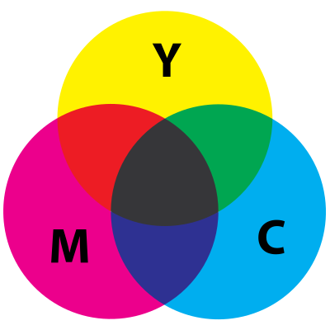
The RGB Color vs. CYM Color
Additive vs. Subtractive
K
Additive and subtractive color models
Notes:
For this class we will not be concerned if a RGB, CYMK or RYB color wheel is use for choosing color harmonies and palettes. The important aspect is, are the choices aesthetically pleasing?
Additive means the color comes from a light source. Subtractive means it is reflected light.
Various methods of explaining:
Subtractive model: CYMK- As an example think of finger painting on white paper or food coloring added to water. As you add colors the surface or volume becomes darker until it is black. It is called subtractive because you are subtracting light by adding colors. By the way, the K stands for black, but it is not actually true black since you cannot absorb all the light. Some light (or color) is always reflected.
Additive model: Projected light from a source. We can demonstrate this using your computer screen. You can change the RGB values by using the Google color picker that comes up first when searching for “online color picker.”
As an interesting alternative:
Use three flashlights and wrap red, green and blue cellophane over the lamp ends. Use a funnel or other cone shaped item and duct tape the flashlights to the outer edge. This separates the lights but points them to a center. When you point the flashlights towards a white board it should look darker in the center, but have defined colors on the outer edges. If you point the flashlights at someone, they should see defined colors on the outer edge and white towards the center. This shows a dramatic representation of reflected (subtractive) vs. projected (additive) colors.

Slide 6
RGB Color Standard
Values between 0 – 255 for each color
256 * 256 * 256 = 16,777,216 colors
Web designers available palette
Specified in CSS (not HTML)
Notes:
This standard in HTML for RGB color allows for 16,777,216 colors by using 0 to 255 as values for each color source of red, green and blue. This provides front-end web developers and designers with a huge palette to work from when creating beautiful web pages. Although the standards are for HTML5 and CSS3, colors are specified only using CSS.
Color standards for the World Wide Web come from the World Wide Web Consortium at https://www.w3.org

Slide 7
RGB Values
Individual colors (red, green, blue)
0 = none of that color
255 = all of that color
Therefore:
RGB(0, 0, 0) produces
RGB(255, 255, 255) produces
RGB(255, 0, 0) produces
Notes:
Using this model, 0 is none of an individual color and 255 is all of an individual color. Therefore RGB(0, 0, 0) is black, RGB(255, 255, 255) is white, RGB(255, 0, 0) is red. We will look at the various ways of expressing these values, but remember they are all based on the RGB 0 to 255 color model.
You may be asking where is the hexadecimal? We will get to that. Using this RGB method is another way we will designate color in web development. Both methods and others we will show, all have their place.

Slide 8
Specify Values in CSS
Supported Color Names
RGB values
HEX values
HSL values (not used in this class)
Notes:
In CSS RGB colors can by specified using various methods, such as:|
Supported Color Names
RGB values
HEX values
HSL values
RGBA
HSLA
There are some other methods, but for this class we will concentrate on supported color names, RGB and HEX values. We will also be using RGB with alpha channel or RGBA. (USE WHITE BOARD) In a very broad sense RGB() and HSL() in CSS are similar to programming “functions”. A function can accept input and return a value. Here the input is the values listed above and the return value is the color on the web page.

Slide 9
Writing Color Values
Color names and HEX values can be written in upper or lower case.
Can be used in many CSS attributes:
background-color
border-color
Color
And many more
Notes:
Both color names and HEX can be written in upper or lower case. Color names, RGB, and HEX values are used in several CSS attributes such as:
• background-color
• border-color
• color
• flood-color
• lighting-color
• outline-color
• scrollbar-color (8 separate scrollbar color attributes)
• stop-color
• text-decoration-color
• text-emphasis-color

Slide 10
Specify Using Named Colors
Support 140 color names.
Only alphabetic characters.
CSS usage: font{color:dodgerblue;}
https://www.w3.org/TR/css-color-3/r
Notes:
To specify using Color Names:
•Modern browsers support 140 color names, actually called extended color keywords.
•There are only alphabetic characters in these color names. No spaces, dashes or other characters and always in lowercase.
•CSS usage: font{color:dodgerblue;} – this style rule assigns the named color "dodgerblue" to a font. Remember I am representing the CSS rule here as it would appear in the inline usage, which puts the code on one line. When using this in a style sheet always format your code for better readability. Some style sheets remove all formatting for quicker downloading to a browser, but we will always use proper formatting in this course.
•Complete list: https://www.w3.org/TR/css-color-3/r

Slide 11
Specify Using Hexadecimal
The values are in triplets
FF*FF*FF=1000000₍₁₆₎
Upper or lower case
Begins with #
Not separated by a comma
CSS usage: font{color:#1E90FF;}
Notes:
To specify using HEXICECIMAL:
HEX is short for hexadecimal (base 16)
The values are three separate hex numbers called triplets
FF*FF*FF=1000000 in HEX or 16,777,216 in decimal.
Can be either uppercase or lowercase (Uppercase more readable – lowercase easy to type)
They begin with the # symbol
They are not separated by a comma
CSS usage: font{color:#1E90FF;} – changes the font color to the HEX value of DodgerBlue.
Usage reminder: this is not a single hex number. It is three separate hex numbers. The 1E is the value for red. The 90 is the value for green. The FF is the value for blue.

Slide 12
Specify Using RGB
Red, green, blue
Values between 0 – 255
Values separated by a comma
256*256*256=16,777,216
CSS usage: font{color:RGB(30,144,255);}
Notes:
To Specify using RGB:
• RGB stands for red, green, blue.
• Color is specified using a value between 0 and 255 for each color.
• The values are separated by a comma.
• 256*256*256=16,777,216 color values.
• CSS usage: font{color:RGB(30,144,255);} – changes the font color to the RGB value of DodgerBlue.

Slide 13
Specify Using HSL
Hue, saturation & lightness
Hue: a degree on the color wheel
Saturation: percentage value of gray
Lightness: percentage value of white
Usage: font{color:HSL(210, 100%, 56%);}
Notes:
To Specify Using HSL:
HSL stands for hue, saturation, and lightness.
Hue is a degree on the color wheel from 0 to 360. 0 is red. (See the color wheel below.)
Saturation is a percentage value; 0% means a shade of gray and 100% is the full color.
Lightness is also a percentage; 0% is black, 100% is white.
CSS usage: font{color:HSL(210, 100%, 56%);} – changes the font color to the HSL value of DodgerBlue.

Slide 14
The HSL (also RGB) Color Wheel
Notes:
Using HSL uses the color wheel a little differently by employing degrees of color and percentages of white and gray.

Slide 15
Alpha Transparency
Stands for alpha channel.
Adds opacity to the color value.
A percentage between 0% and 100%.
Not used with supported color names.
Notes:
Stands for alpha channel.
Adds opacity (transparency) to the color value.
Represents a percentage between 0% and 100%.
Cannot be used with supported color names.

Slide 16
Alpha Values
HEX: 00 (fully transparent), FF (fully opaque).
HEX number becomes an octet
RGBA and HSLA values between 0.0 (fully transparent) and 1.0 (fully opaque).
Notes:
HEX values between 00 (fully transparent) and FF (fully opaque).
HEX adding an alpha value changes HEX number from a triplet to an octet (four separate numbers)
RGBA and HSLA values between 0.0 (fully transparent) and 1.0 (fully opaque).
CSS usage with color names: none.

Slide 17
CSS Usage with Alpha
HEX - font{color:#1E90FF80;}
RGBA: font{color:RGBA(30,144,255,0.5);}
Preferred usage
HSLA: font{color:HSLA(210, 100%, 56%, 0.5);}
Will not be used in this class
Notes:
Here are three methods of adding transparency to the color dodgerblue. Of course we are not using the named color dodgerblue, but instead we can use the HEX, RGB or HSLA value for dodgerblue to incorporate transparency.
CSS usage for HEX - font{color:#1E90FF80;} – sets the font color to the HEX value of DodgerBlue with 50% transparency. (this is not the preferred usage.)
CSS usage for RGBA: font{color:RGBA(30,144,255,0.5);} – sets the font color to the RGB value of DodgerBlue with 50% transparency. (preferred usage!)
CSS usage for HSLA: font{color:HSLA(210, 100%, 56%, 0.5);} – sets the font color to the HSL value of DodgerBlue with 50% transparency.

Slide 18
Web Design vs. Web Coding
This class teaches HTML & CSS
Can’t teach aesthetic, artistic design.
Can’t teach how to create an visually appealing and beautiful website.
Notes:
There is a difference between coding or building a website, and the artistic aspect of designing the website. I am not an art teacher, so I can’t teach you what is artistically appealing.
That being said, I know what I like. Although I may not know exactly or from an art and color theory standpoint, what art is, I do know what I like and what I find appealing. There are a few simple rules for design which we will take a closer look at, but we will not have the time in this class to go deeper into design.

Slide 19
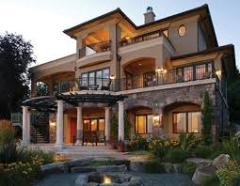
Construction vs. Design
You can construct a house like this:
Or, you can construct a house like this:
Notes:
The fact is you can use the HTML and CSS you learn in this class to construct either type of web page.

Slide 20
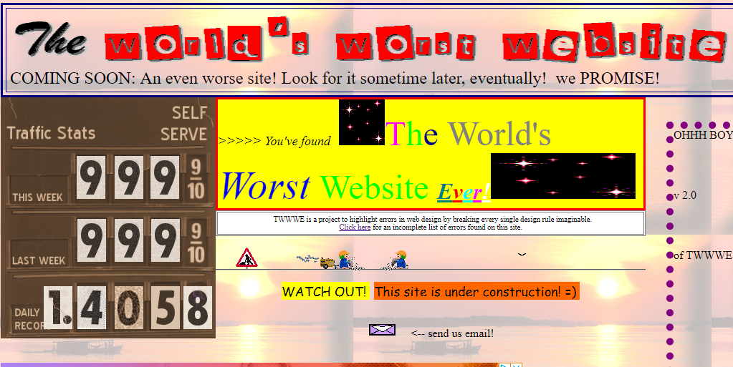
Bad Example
You can construct a website like this:
Notes:
Here is a bad example of an actual website located at theworldsworstwebsiteever.com

Slide 21
Good Example
Or you can construct a website like this:
Notes:
Here is just one example I consider to be a well designed website.

Slide 22
My Top Four Tips
Use no more than three fonts.
Main font very “readable.”
Use no more than 3 or 4 theme colors.
Use the color wheel and other color tools.
Plan ahead.
Look at other designers work!
Notes:
I have included for this class several Infographics for visually appealing web design. Use them!
Here a four simple design ideas to keep in mind.

Slide 23
The color wheel!
Harmonies or chords
Attractive combinations
Uses two or more colors
Notes:
Using a color wheel and color chords can allow us to come up with some good website color schemes.

Slide 24
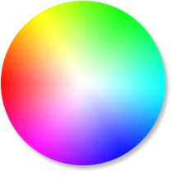
Harmonies
Complementary
Monochromatic
Analogous
Split Complementary
Triadic
Tetradic
https://www.sessions.edu/color-calculator/
Notes:
The major harmonies using the RGB color wheel.

Slide 25
Shades, tints and tones!
Shades: adding black to a color
Tints: adding white to a color
Tones: adding gray to a color

Slide 26
Assignment
Reading:
https://www.sessions.edu/color-calculator/
http://htmlcolorcodes.com/color-picker/
Notes:
Reading assignment for this lesson.

Slide 27
Assignment
Task:
After reading the assignment, use the Color Calculator at www.sessions.edu to design what you think would be an appealing color scheme for a webpage or website.
Choose one color and a harmony that includes at least two more colors.
Follow the directions to “Get Color Scheme” and use that information for the assignment below.
Notes:
You can use any of the color schemers I have supplied, but the easiest is probably sessions.edu or htmlcolorcodes.com.
Get your color scheme or palette
Use the template in the notes for the next slide.
Fill in the values of your own color scheme
Your finished web page should look like my example web page (below) except with your color values.

Slide 28
Assignment: My Color Scheme
Notes:
Use the HTML below to create a web page and fill in the values of your own color scheme, using each color and the background of each <DIV>. If the background color is too dark for black text, change the color attribute for the <DIV> to white. Be sure to save your file as HTML.
-------------------------Code------------------------------------
<!DOCTYPE html>
<html>
<body>
<div style="background-color:#234099;color:white; padding:20px;">
<h2>1st Color</h2>
<p>
Hex value: #234099<br/>
RGB value: 114 156 255
</p>
</div>
<div style="background-color:#ffd272; padding:20px;">
<h2>2nd Color</h2>
<p>
Hex value: #234099<br/>
RGB value: 255 210 114
</p>
</div>
<div style="background-color:#ff8c72; padding:20px;">
<h2>3rd Color</h2>
<p>
Hex value: #ff8c72<br/>
RGB value: 255 140 114
</p>
</div>
</body>
</html>
----------------End Code----------------------------

Slide 29
Add to your Favorites
Online color pickers
https://www.w3schools.com/colors/colors_picker.asp
https://developer.mozilla.org/en-US/docs/Web/CSS/CSS_Colors/Color_picker_tool
http://htmlcolorcodes.com/color-picker/
Online color schemes
http://paletton.com/#uid=1000u0kllllaFw0g0qFqFg0w0aF
https://www.sessions.edu/color-calculator/
Color tutorials
https://www.w3schools.com/colors/default.asp
https://webdesign.tutsplus.com/articles/an-introduction-to-color-theory-for-web-designers--webdesign-1437
Notes:
Online color resources.

